Slide 1
AASD4011: Mathematical Concepts for Deep Learning
Setting Up a Development Environment

Slide 2
Three Types of Environments:
Local Computer
Remote Computer (for example AWS EC2)
Online Notebooks Service (such as Google Colab or Kaggle Notebooks)

Slide 3
Three Types of Environments:
Local Computer
Remote Computer (for example AWS EC2)
Online Notebooks Service (such as Google Colab or Kaggle Notebooks)
The recommendation is to start with (1) for part one of the course, and then consider either option (2) or (3) for part two.
A local environment sets up a developer for the work in industry, and for deploying models. However, it is less complex than setting up a remote environment. An online notebook service is an excellent choice for the short-term, but it abstracts out some of the processes required to deploy a DL model in production.

Slide 4



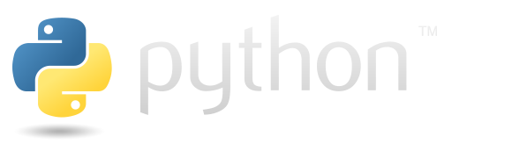

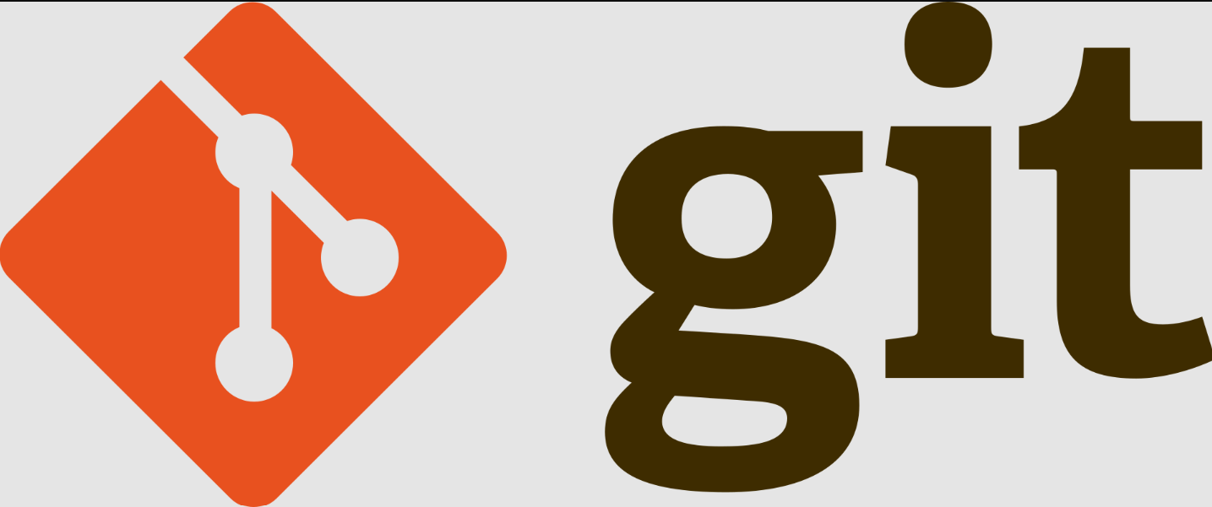


CLI
Running Code and maintaining envs
Code Editor
Code Collaboration and Version Control
Interactive Code

Slide 5
Setting Up a Development Environment
Git
Github Account
Python 3.7-3.11.x (the code was tested on Python 3.10.9 and 3.11.3 on Windows)
Python’s built-in venv to create virtual environments
Python’s PIP to install Python packages

Slide 6
Command Line Interface
CLI

Slide 7
Linux (e.g. Ubuntu)
In most Linux distributions, including Ubuntu, the default shell is bash.
https://www.gnu.org/software/bash/

Slide 8
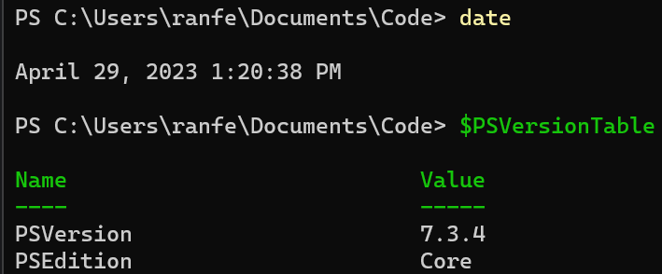
Windows
CMD
Windows Powershell (5.1)
Powershell Core (7.x) - recommended (installation)
Check your version: $PSVersionTable
https://learn.microsoft.com/en-us/powershell/
https://github.com/PowerShell/PowerShell
PS is partially compatible with Linux’ Bash

Slide 9
macOS
The default shell in macOS is the Z shell (commonly known as Zsh)
It is mostly compatible with linux’s Bash

Slide 10
Setting Up a Development Environment
Recommended IDE: VSCode
Free and built on Open-Source
Build in support for Github and Jupyter Notebooks
Support for Remote Connection via SSH (e.g. to AWS EC2)
Innovative (e.g. CoPilot Support)
Most-popular IDE as of December 2022 (reference), and trending up

Slide 11
Git and Github

Slide 12
Git - a version control system
Repository:
Local:
Status
Add a file
Commit
Remote:
Clone
Push
Pull
https://git-scm.com/

Slide 13
Set a Github account
Create a repository
Clone the repository (requires GIT)

Slide 14
Setting up Git on Your Laptop
Open a terminal and check if git is already installed by typing `git --version`
Download and install Git. You can download Git from this URL: https://git-scm.com/downloads
Verify the installation by typing `git --version` into your terminal.
Set up your user name and email address for Git to track who is making changes. You can do this by typing the following commands:
`git config --global user.name "Your Name"`
`git config --global user.email "your_email@example.com"`

Slide 15
Making Changes, Commit, and Push
Navigate to your local repository on your computer using the terminal.
You can make changes to the existing files or create new ones.
After making changes, type `git status` to see the changes Git has tracked.
Add the changes to the staging area using `git add .` (The '.' means all changes are added. If you want to add specific files, replace '.' with the file's name)
Commit your changes using `git commit -m "Your meaningful commit message"`
Push your changes to the remote repository using `git push`

Slide 16
Python and Virtual Environments
Running Code and maintaining envs

Slide 17
Setting Up a Development Environment
Why venv and pip?
virtual environments – activation and direct usage
Requirements.txt files, versioning
.gitignore
Code owners file
Folder Organization
Git branches and rebase

Slide 18
Jupyter Notebooks
Interactive Code

